Slide 1
React Props Validation

Slide 2
Props are an important mechanism for passing the read-only attributes to React components.
The props are usually required to use correctly in the component.
If it is not used correctly, the components may not behave as expected.
Hence, it is required to use props validation in improving react components.

Slide 3
Validating Props
App.propTypes is used for props validation in react component. When some of the props are passed with an invalid type, you will get the warnings on JavaScript console.
After specifying the validation patterns, you will set the
App.defaultProps.
class App extends React.Component {
render() {}
}
Component.propTypes = { /*Definition */};

Slide 4
ReactJS Props Validator ReactJS props validator contains the following list of validators.
SN | PropsType | Description
1. | PropTypes.any | The props can be of any data type.
2. | PropTypes.array | The props should be an array.
3. | PropTypes.bool | The props should be a boolean.
4. | PropTypes.func | The props should be a function.
5. | PropTypes.number | The props should be a number.
6. | PropTypes.object | The props should be an object.
7. | PropTypes.string | The props should be a string.
8. | PropTypes.symbol | The props should be a symbol.
9. | PropTypes.instanceOf | The props should be an instance of a particular JavaScript class.
10. | PropTypes.isRequired | The props must be provided.
11. | PropTypes.element | The props must be an element.
12. | PropTypes.node | The props can render anything: numbers, strings, elements or an array (or fragment) containing these types.
13. | PropTypes.oneOf() | The props should be one of several types of specific values.
14. | PropTypes.oneOfType([PropTypes.string,PropTypes.number]) | The props should be an object that could be one of many t

Slide 5
we are creating an App component which contains all the props that we need. In this example, App.propTypes is used for props validation. For props validation, you must have to add this line: import propTypes from 'prop-types' in App.js file.

Slide 6
App.js
import React, { Component } from 'react';
import PropTypes from 'prop-types';
class App extends React.Component {
render() {
return (
<div>
<h1>ReactJS Props validation example</h1>
<table>
<tr><th>Type</th> <th>Value</th> </tr>
<tr><td>Array</td> <td>{this.props.propArray}</td> </tr>
<tr><td>Boolean</td><td>{this.props.propBool ? "true" : "False"}</td></tr>
<tr><td>Function</td><td>{this.props.propFunc(5)}</td></tr>
<tr><td>String</td><td>{this.props.propString}</td></tr>
<tr><td>Number</td><td>{this.props.propNumber}</td></tr>
</table>
</div>
); } }

Slide 7
App.js
App.propTypes = {
propArray: PropTypes.array.isRequired,
propBool: PropTypes.bool.isRequired,
propFunc: PropTypes.func,
propNumber: PropTypes.number,
propString: PropTypes.string,
}
App.defaultProps = {
propArray: [1,2,3,4,5],
propBool: true,
propFunc: function(x){return x+5},
propNumber: 1,
propString: "Welcome to LPU",
}
export default App;

Slide 8
Main.js
import React from 'react';
import ReactDOM from 'react-dom';
import App from './App.js';
ReactDOM.render(<App/>, document.getElementById('root'));

Slide 9
ReactJS Custom Validators
ReactJS allows creating a custom validation function to perform custom validation. The following argument is used to create a custom validation function.
props: It should be the first argument in the component.
propName: It is the propName that is going to validate.
componentName: It is the componentName that are going to validated again.

Slide 10
var Component = React.createClass({
App.propTypes = {
customProp: function(props, propName, componentName) {
if (!item.isValid(props[propName])) {
return new Error('Validation failed!');
}
}
}
})

Slide 11
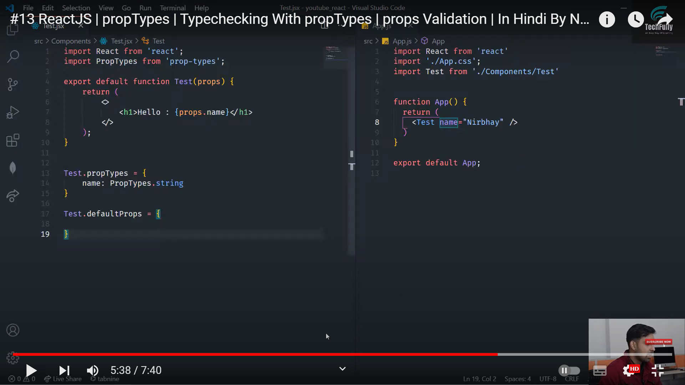
Example -2

Slide 12
